Slide 1
Ch-12. Packages
Visualizing, specifying, constructing, and documenting large systems involves manipulating potentially large numbers of classes, interfaces, components, nodes, diagrams, and other elements.
In the UML, the package is a general purpose mechanism for organizing modeling elements into groups.

Slide 2
A package is a general-purpose mechanism for organizing elements into groups. Graphically, a package is rendered as a tabbed folder.
Names:-
A package name must be unique within its enclosing package.
Every package must have a name that distinguishes it from other packages.

Slide 3
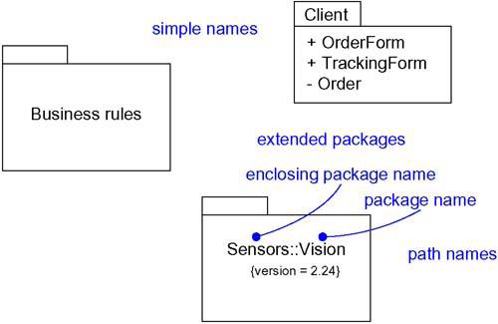

Slide 4
Owned Elements:-
A package may own other elements, including classes, interfaces, components, nodes, collaborations, use cases, diagrams, and even other packages.
Owning is a composite relationship, which means that the element is declared in the package. If the package is destroyed, the element is destroyed.

Slide 5
A package forms a namespace, which means that elements of the same kind must be named uniquely within the context of its enclosing package.
For example, you can't have two classes named Queue owned by the same package, but you can have a class named Queue in package P1 and another (and different) class named Queue in package P2. The classes P1::Queue and P2::Queue are, in fact, different classes and can be distinguished by their path names.

Slide 6
Elements of different kinds may have the same name within a package.
Thus, you can have a class named Timer, as well as a component named Timer, within the same package.

Slide 7
Packages may own other packages. This means that it's possible to decompose your models hierarchically.
For example, you might have a class named Camera that lives in the package Vision that in turn lives in the package Sensors. The full name of this class is Sensors :: Vision :: Camera.

Slide 8
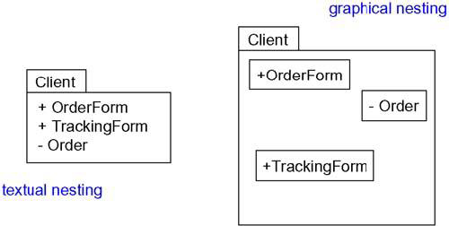
Visibility:-
The visibility of the elements owned by a package is just as you can control the visibility of the attributes and operations owned by a class.

Slide 9
In the Figure, OrderForm is a public part of the package Client, and Order is a private part.
A package that imports Client can see OrderForm, but it cannot see Order.
As viewed from the outside, the fully qualified name of OrderForm would be Client::OrderForm.

Slide 10
Protected elements are visible only to packages that inherit from another package;
Private elements are not visible outside the package at all.

Slide 11
Importing and Exporting:-
Suppose you have two classes named A and B sitting side by side. Because they are peers, A can see B and B can see A, so both can depend on the other. Just two classes makes for a trivial system, so you really don't need any kind of packaging.

Slide 12
Now, imagine having a few hundred such classes sitting side by side.
Furthermore, there's no way that you can understand such a large, unorganized group of classes. That's a very real problem for large systems--simple, unrestrained access does not scale up. For these situations, you need some kind of controlled packaging to organize your abstractions.

Slide 13
Importing grants a one-way permission for the elements in one package to access the elements in another package.
In the UML, you model an import relationship as a dependency adorned with the stereotype import.

Slide 14
The public parts of a package are called its exports.
For example, in Figure, the package GUI exports two classes, Window and Form. EventHandler is not exported by GUI; EventHandler is a protected part of the package.

Slide 15
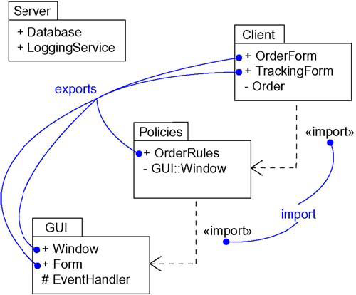

Slide 16
Generalization
There are two kinds of relationships you can have between packages: import and access dependencies, used to import into one package elements exported from another, and generalizations, used to specify families of packages.

Slide 17
Generalization among packages is very much like generalization among classes.
For example, in Figure, the package GUI is shown to export two classes (Window and Form) and one protected class (EventHandler).
Two packages specialize the more general package GUI: WindowsGUI and MacGUI. These specialized packages inherit the public and protected elements of the more general package.

Slide 18
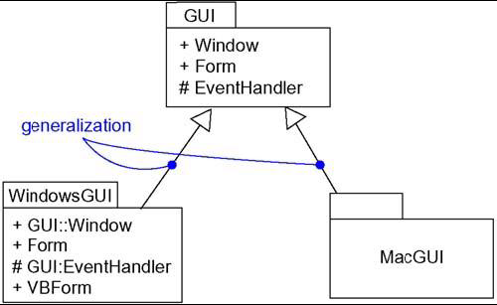

Slide 19
Standard Elements
All of the UML's extensibility mechanisms apply to packages.
The UML defines five standard stereotypes that apply to packages.
facade: Specifies a package that is only a view on some other package.
framework: Specifies a package consisting mainly of patterns

Slide 20
stub: Specifies a package that serves as a proxy for the public contents of another package.
subsystem: Specifies a package representing an independent part of the entire system being modeled.
system: Specifies a package representing the entire system being modeled.

Slide 21
Common Modeling Techniques
Modeling Groups of Elements
Scan the modeling elements in a particular architectural view and look for clumps defined by elements that are conceptually or semantically close to one another.
Surround each of these clumps in a package.

Slide 22
For each package, distinguish which elements should be accessible outside the package. Mark them public, and all others protected or private. When in doubt, hide the element.
Explicitly connect packages that build on others via import dependencies.
In the case of families of packages, connect specialized packages to their more general part via generalizations.

Slide 23
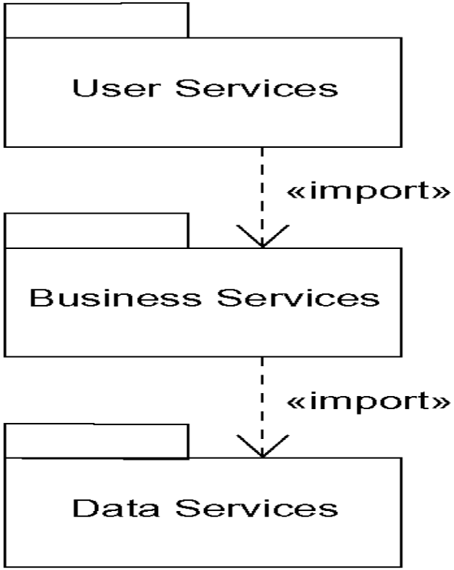
Modeling Groups of Elements

Slide 24
Modeling Architectural Views:-
Identify the set of architectural views that are significant in the context of your problem. In practice, this typically includes a design view, a process view, an implementation view, a deployment view, and a use case view.
Place the elements (and diagrams) that are necessary and sufficient to visualize, specify, construct, and document the semantics of each view into the appropriate package.

Slide 25
As necessary, further group these elements into their own packages.
There will typically be dependencies across the elements in different views. So, in general, let each view at the top of a system be open to all others at that level.

Slide 26
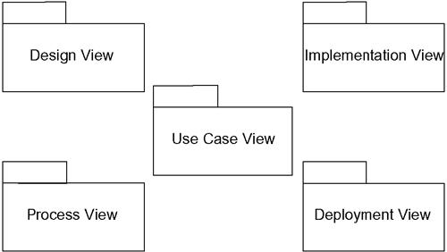
Modeling Architectural Views

